Slide 1

Approaching Curricular Reform
IAMSE WAS 09.26.24
Katie Huggett, Ph.D.
Director, The Teaching Academy
Robert Larner, M.D. ’42 Professor of Medical Education
Assistant Dean for Medical Education

Slide 2
Disclosures
There are no conflicts of interest to declare
Dr. Huggett is a co-editor of An Introduction to Medical Teaching: The Foundations of Curriculum Design, Delivery, and Assessment (Springer, 2022)
THE TEACHING ACADEMY

Slide 3

Getting Started
Finding resources
Managing the process
Preparing your learners
Supporting your faculty
THE TEACHING ACADEMY

Slide 4








Finding Resources
Scientific/Specialty societies
Accrediting organizations
Curriculum design frameworks and models
Health professions literature
THE TEACHING ACADEMY

Slide 5

Managing the Process
People
Planning/Implementation Structures
Timeline
Tools
Software
THE TEACHING ACADEMY

Slide 6

Preparing your learners
Student committee members
Student leaders
Sharing the rationale and literature
Focus groups
THE TEACHING ACADEMY

Slide 7



Supporting your faculty
Access to support
Provide Time, Allow Time
Input and engagement with the process
Nurture Communities of Practice
Acknowledge the ZFI and ZOT
(Smith, Stark, Sanchez 2019)
(Huggett, Smith, Hsieh, Ownby 2024)
(Rogan JM and Anderson TR 2006)
THE TEACHING ACADEMY

Slide 8
References
Fink LD. Creating significant learning experiences: An integrated approach to designing college courses. John Wiley & Sons; 2013 Jul 31.
Heck AJ, Cross CE, Tatum VY, Chase AJ. Active learning among health professions’ educators: Perceptions, barriers, and use. Medical Science Educator. 2023 Jun;33(3):719-27.
Huggett KN, Smith GA, Hsieh P, Ownby AR. 2024. A Phenomenographic Study of How Medical School Faculty Experienced the Transition from Lectures to Active Learning [Manuscript submitted for publication].
Robeson, B.L., Fitzgerald, A.S. (2023). Project Planning and Logistics. In: Fitzgerald, A.S., Bosch, G. (eds) Education Scholarship in Healthcare. Springer, Cham. https://doi.org/10.1007/978-3-031-38534-6_14
THE TEACHING ACADEMY

Slide 9
References, cont’d
Rogan JM, Anderson TR. Bridging the educational research‐teaching practice gap: Curriculum development, Part 2: Becoming an agent of change. Biochemistry and molecular biology education. 2011 May;39(3):233-41.
Smith GA, Stark A, Sanchez J. What Does Course Design Mean to College Science and Mathematics Teachers?. Journal of College Science Teaching. 2019 Mar 1;48(4):81-91.
Thomas PA, Kern DE, Hughes MT, Tackett SA, Chen BY, editors. Curriculum development for medical education: a six-step approach. JHU press; 2022 Aug 30.
THE TEACHING ACADEMY

Slide 10



How to Approach Curricular Reform
Yerko Berrocal, MD, MHPE
Associate Dean,
Curricular Affairs
yerko.berrocal@alwmed.org

Slide 11
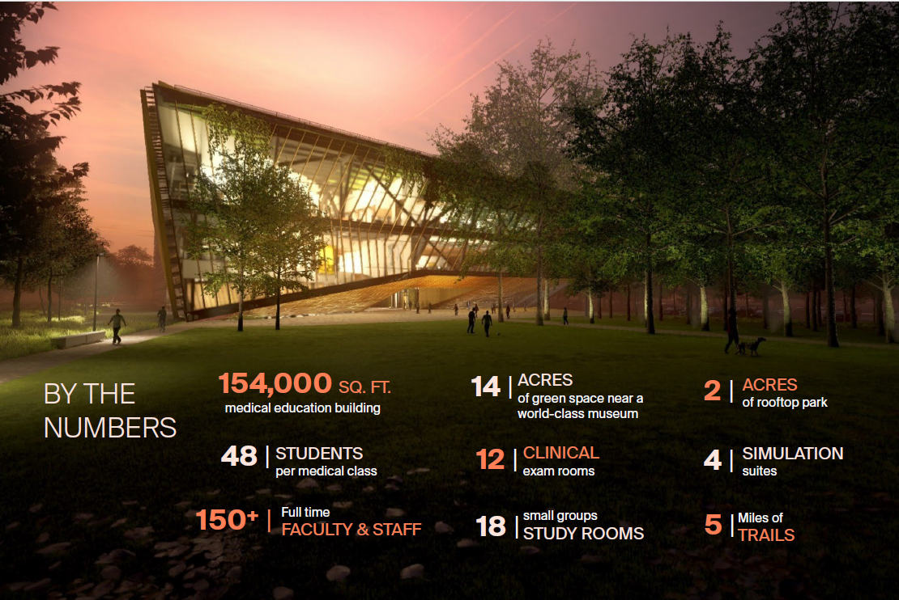
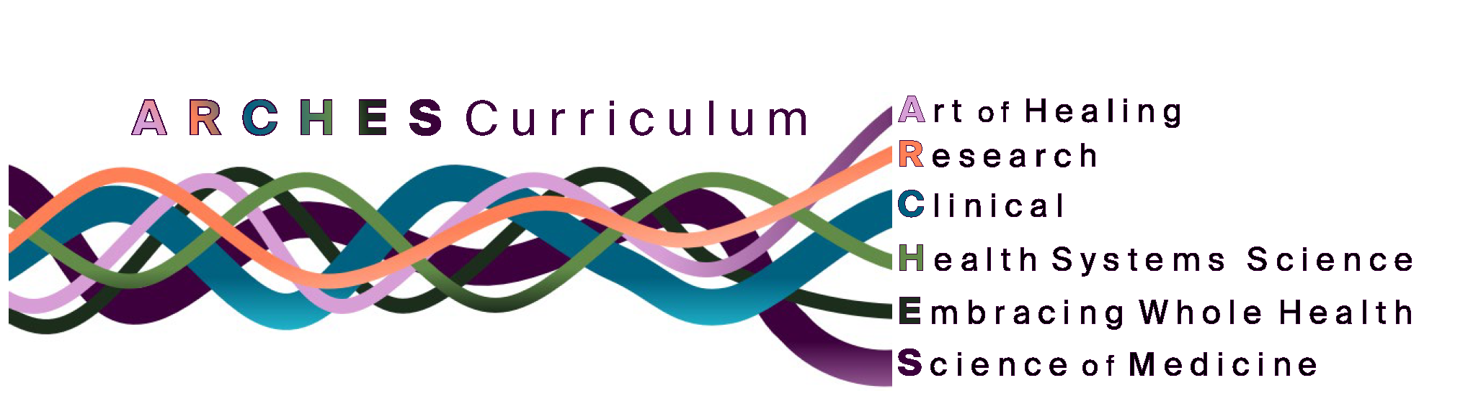
Alice L. Walton School of Medicine
Bentonville, Arkansas, USA
https://alwmedschool.org/curriculum/

Slide 12
Outline – Curricular Reform/Development
My Vision
Why?
Approach
Challenges
Lessons Learned
Conclusions

Slide 13

Why?
Competency-based education
Rapid evolution/advancements in medical education & technology
Patient-Centered care
Lifelong learning and adaptability
Interdisciplinary approach
Emphasis on preventive medicine & public health
Mental health
Burnout and well-being

Slide 14
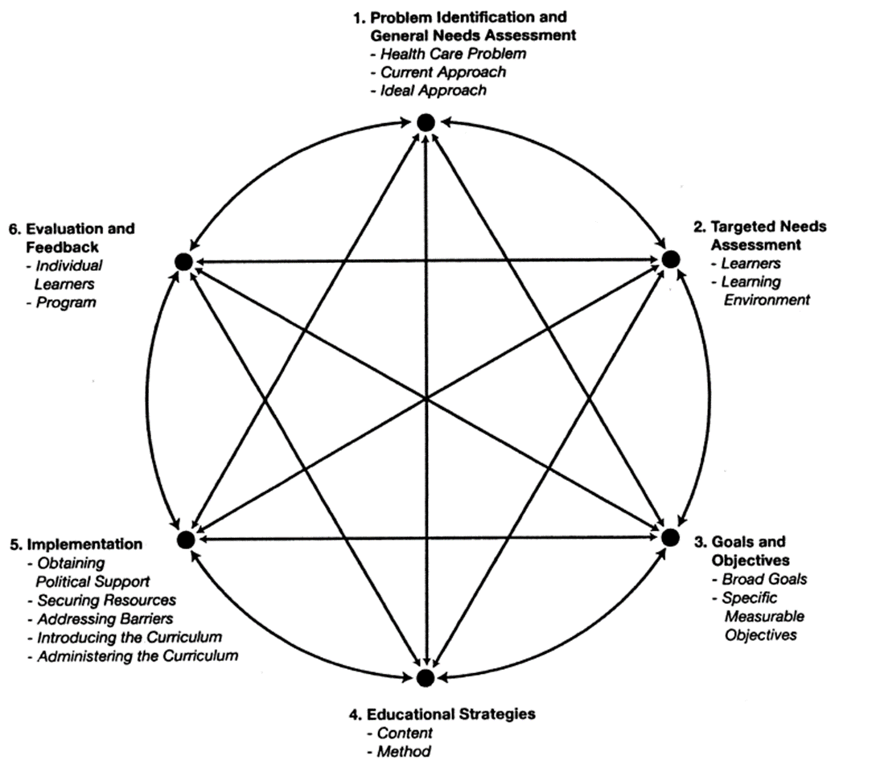
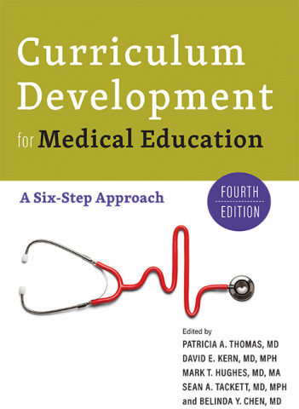
My Vision
Approach
“The Bottom Line”
  What is most worthwhile?
  Why is it worthwhile?
  How is it acquired or created?
Thomas PA, et al. Curriculum Development for Medical Education. A Six-Step Approach. John Hopkins University, 2016

Slide 15
Challenges (a few)
My Vision
Resistance to change:
Faculty/Staff
Students
Resources
Time Constraints
Assessment
& Evaluation
Curriculum Design
& Integration
Accreditation
Barriers between the basic and clinical sciences
Faculty &
Students
Technology/Simulation Integration
Addressing these challenges requires communication, stakeholder engagement, collaboration, adaptability, and a student-centered approach

Slide 16
Lessons Learned
All curriculum decisions must be based on a statement of vision, mission, and values, which must be emphasized from the beginning.
Stakeholder engagement
Flexibility and adaptability
Full-time medical educators
Class size to allow for active learning
Assessment and evaluation(emphasis on formative assessments)
Student-centered approach
Faculty development
Stay the course – don’t’ change too often

Slide 17
Conclusions
My Vision
It is essential to consider conceptual frameworks that will inform the curricular reform.
Engage stakeholders early and often
Prioritize Flexibility and Adaptability
Ensure Adequate Resources: time, funding & faculty development
Balance innovation with core values
Develop robust assessment and evaluation methods
Foster a supportive institutional culture: promote integration and interdisciplinary collaboration
Focus on student-centered learning
Integrate technology thoughtfully

Slide 18
Thank you!

Slide 19
How to approach Curriculum reform
AKU experience
Prof Robert Opoka, MD, MHPE, PhD
Assoc Dean Undergraduate Medical Education
Aga Khan University, Nairobi Kenya

Slide 20

Medical College East Africa, Aga Khan University
2 campuses, Dar es salaam (Tz) & Nairobi (Kenya).
Recently introduced a MBChB program at Nairobi
Unique program
  Innovative delivery methodologies
  Standard setting in the region

Slide 21
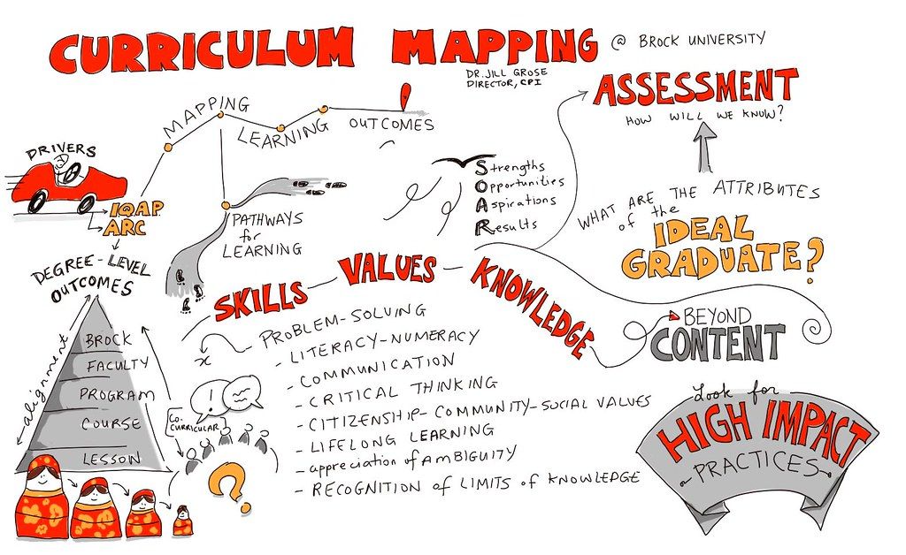
MBChB 3.0
An intergration of contemporary theories student centred learning approaches and adult learning
Innovative delivery methodologies
Emphasis on Impact, Quality, Relevance and Access

Slide 22
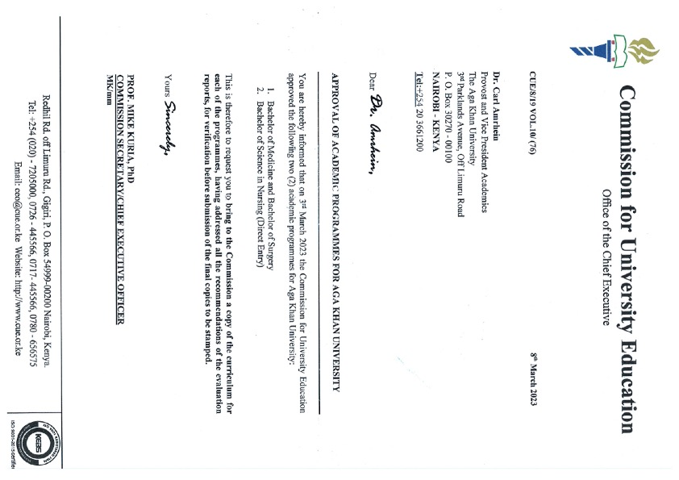

Curriculum development
Since 2004
2020-2022
March 2023

Slide 23

Phase I – Infrastructure
Established a teaching hospital
Introduced a Residency and Fellowship programs (2004)
Other support entities
  Library
  Quality teaching and learning
Designed a the MBChB curriculum
Notes:
What do these numbers mean for business?

Slide 24





Where we are: 2024
14
151/31
7
173
353
Residency Programmes
Faculty/Staff
Clinical Fellowship
Programmes
Current students
Alumni

Slide 25






Phase 2: Needs assessment
Doctors & Other Specialised Health Workers
in East Africa
Need
Locally Trained Experts
that can
Address Shifting Patterns
Innovative Medical Experts able to
Generate Locally Relevant Solutions
Integration of Technology
To Manage Rapidly Evolving Medical Landscape
Community Focus
Appreciating
Diversity, Cross-cultural Sensitivity &
Appropriate Communication
Redesigning Learning
to Simulate

Slide 26
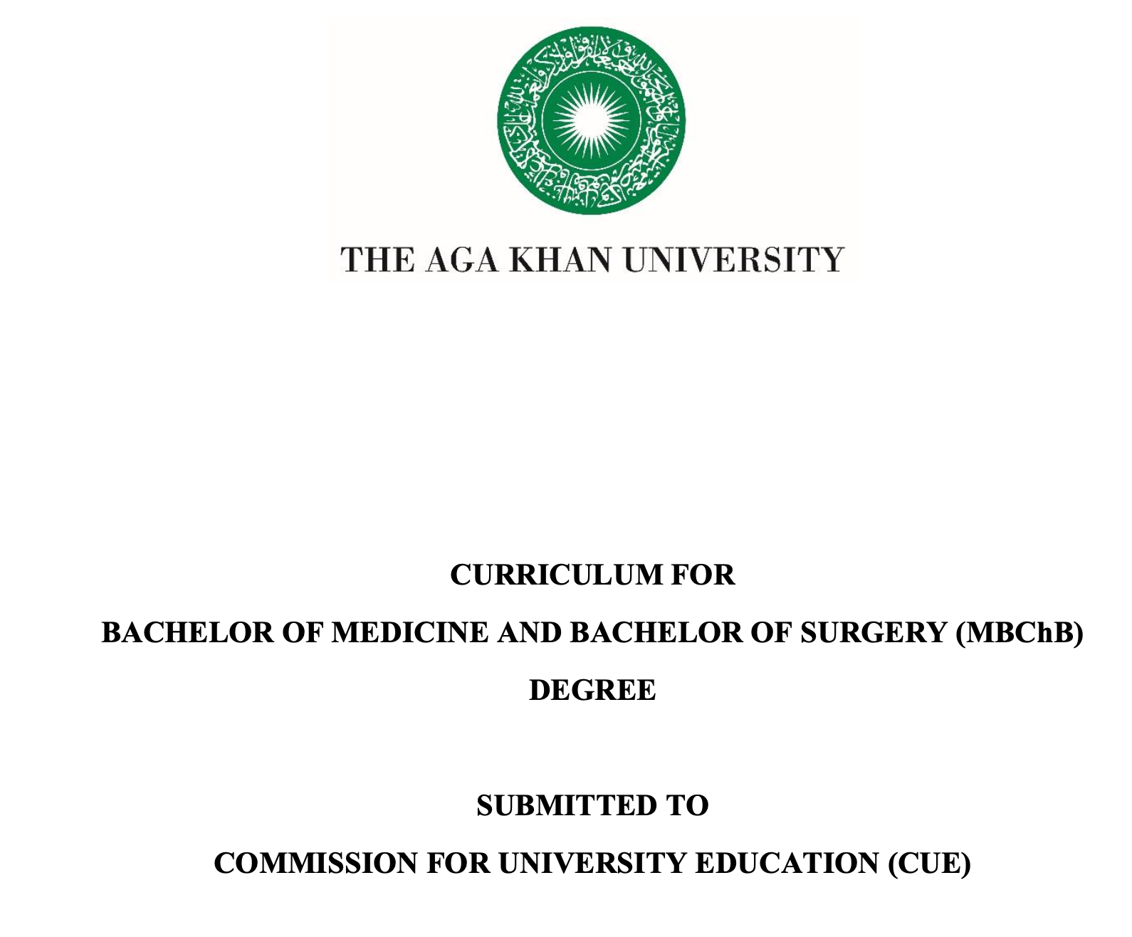

Phase 3: Implementation

Slide 27

Cohort 1

Slide 28
Challenges
Compliance with old requirements and regulations.
Change in mind set – from for service to academic center.
Faculty development and re-training and orientation
Student/learner buy in and orientation

Slide 29

Thank you

